Slide 1
BUSINESS ANALYTICS DS422
Analytics In Fraud Detection

Slide 2
TEAM DETAILS
1. Kumari Renuka
2. Sangamesh Kotalwar
3. Rishabh Kumar Kandoi
4. Antra Tripathi
5. Mayank Singh
6. Prajwal B Ainapur
U101115FCS111
U101115FCS210
U101115FCS283
U101115FCS055
U101115FCS200
U101115FEC239

Slide 3
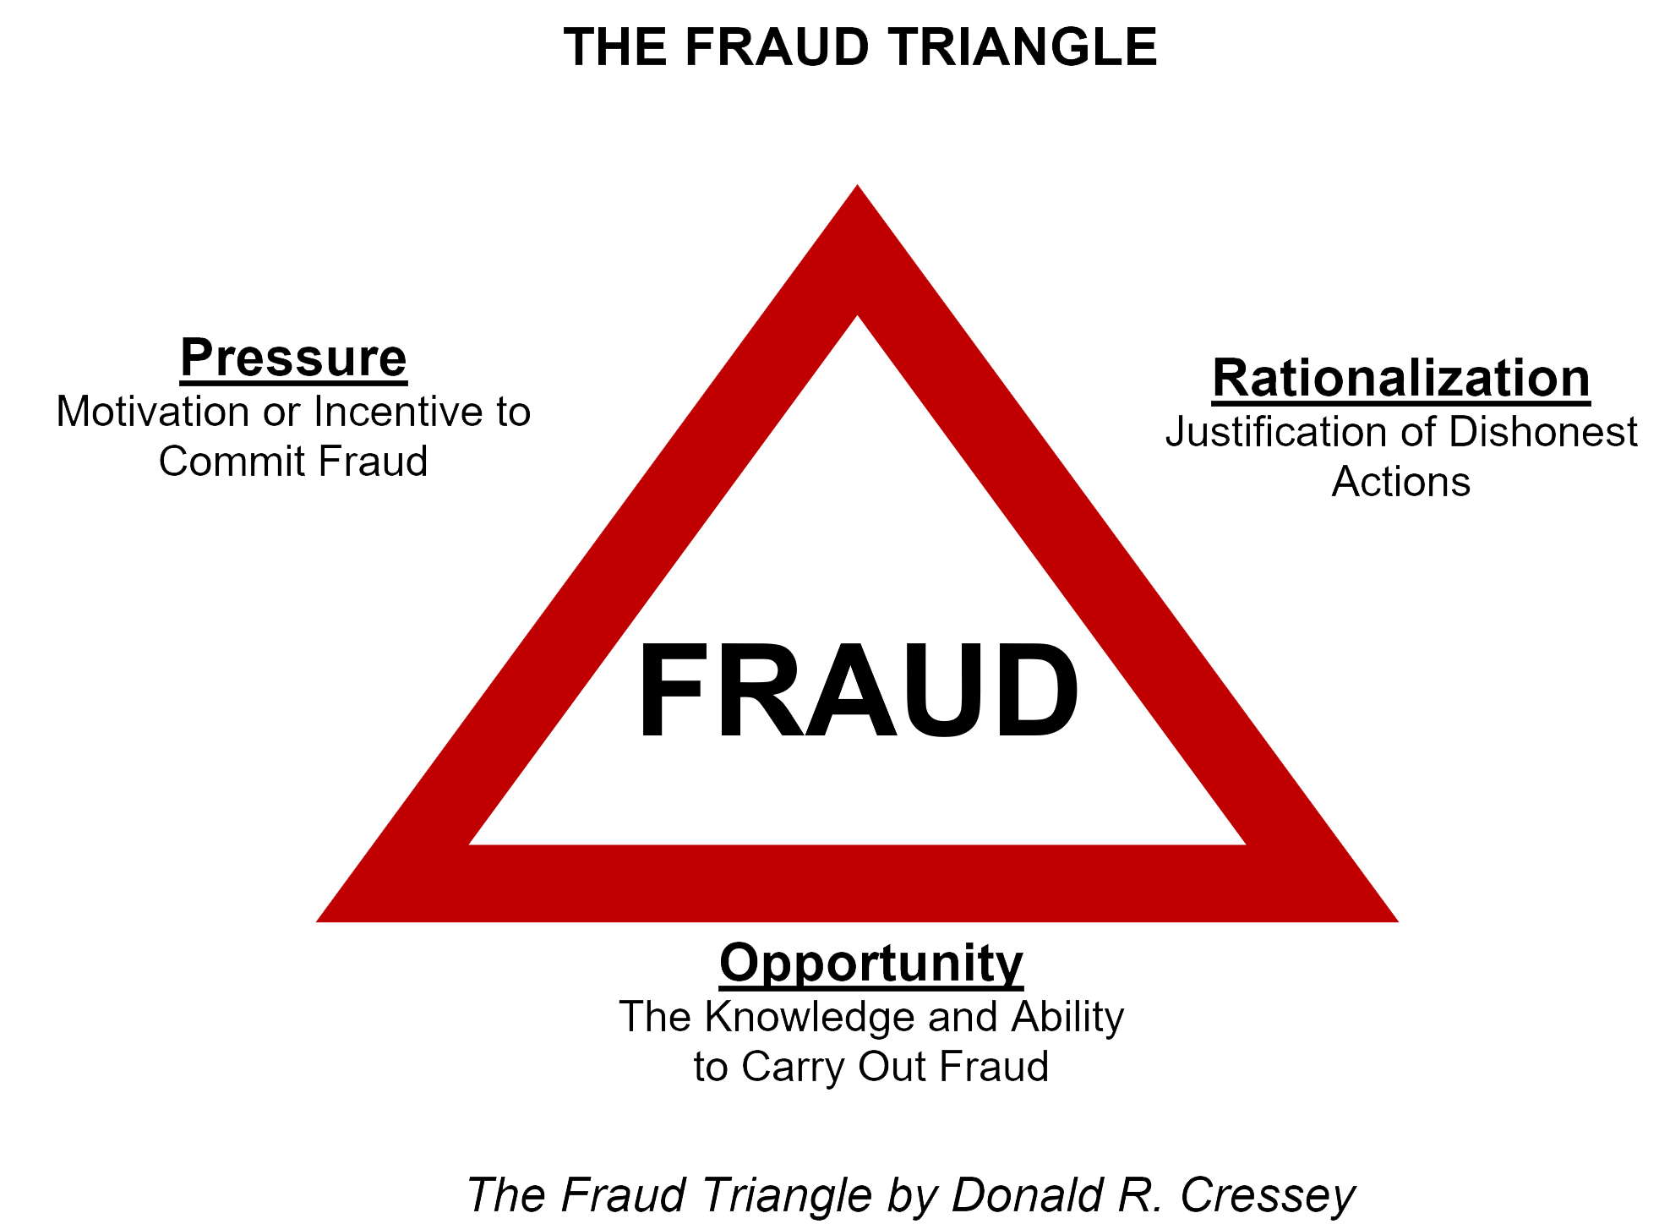
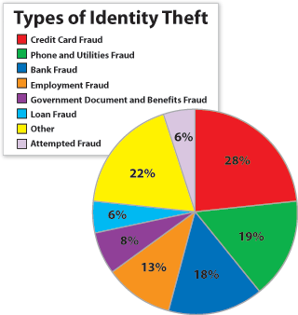
WHAT IS FRAUD ?
An illegal act of involving or obtaining something of value through wilful misrepresentation.

Slide 4
INTRODUCTION TO ANALYTICS IN FRAUD
FRAUD ANALYTICS
It’s a combination of analytic technology with human interaction which will help to detect the possible improper transactions like fraud or bribery either before the transaction is done or after the transaction is done.
REASON FOR ANALYTICS
Traditional Anomaly Detection method is not powerful.
They have limited scope
Fraud analytics also helps to measure the performance which will us to standardize and have a control for constant improvement
BENEFITS
Identify Hidden Patterns
Data Integration
Enhance existing efforts
Harnessing unstructured data
Improve the performance

Slide 5
KEY CHARACTERISTICS OF SUCCESSFUL FRAUD ANALYTICS MODEL
Statistical Accuracy
Interpretability
Economical cost
Operational Efficiency
Regulatory compliance

Slide 6
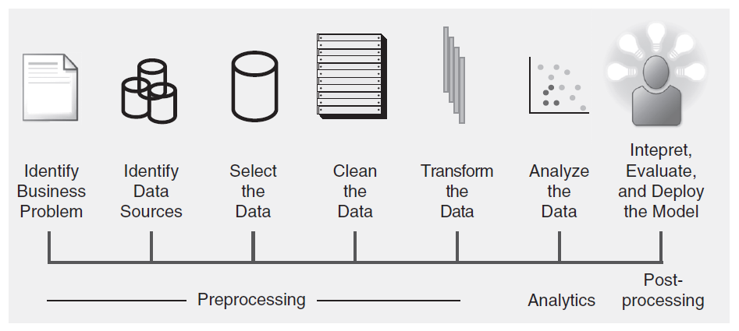
FRAUD ANALYTICS PROCESS MODEL

Slide 7
DESCRIPTIVE ANALYTICS
Statistical ODP
Break-point analysis, Peer-group analysis, Association rule
Graphical ODP
Boxplot, Histogram, Scatter Plot
Clustering
K-Means
Aims at finding unusual anomalous behaviour deviating from the average behaviour or norm.
USAGE-
Unsupervised learning can be useful for organizations that start doing fraud detection and thus have no labelled historical data set available.
It can also be used in existing fraud models by uncovering new fraud mechanisms.
ODP~ outlier detection procedure

Slide 8
PREDICTIVE ANALYTICS
In predictive analytics, the aim is to build an analytical model predicting a target measure of interest.
USAGE-
Supervised learning can be useful for organizations which consist of availability of a historical data set with known fraudulent transactions.
The analytical models built can thus only detect fraud patterns as they occurred in the past
Regression
1) Linear and multiple regression
Classification
1) Logistic regression
2) Decision Tree

Slide 9
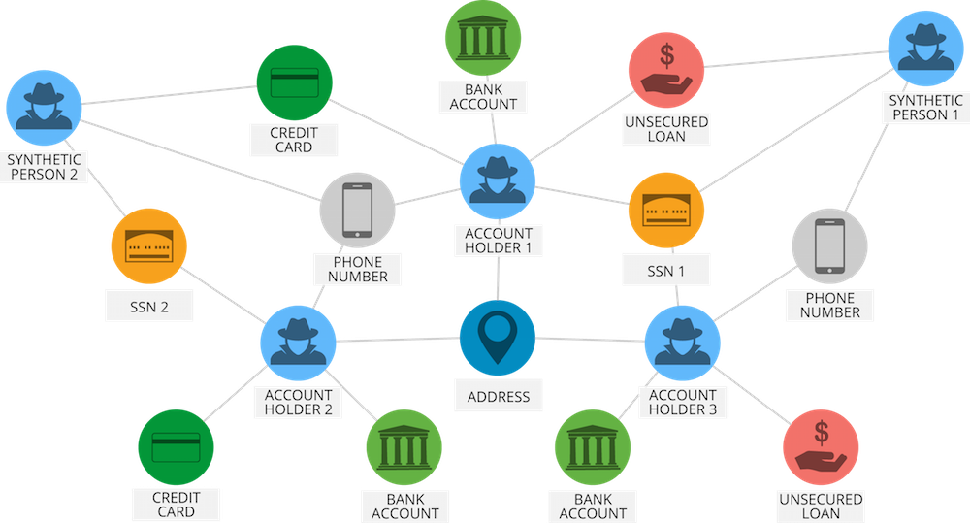
Social Analysis

Slide 10
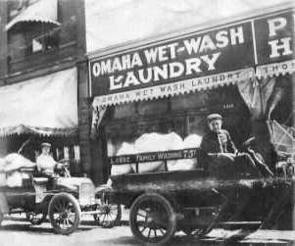
SCHEME : LAUNDROMATS AND SWISS BANK
Case Study 1:
Money Laundering

Slide 11
END OF THE CRIME LORD
Capone made sure that his name doesn’t appear at any of the properties or schemes using middlemen for the same.
But the U.S. Government finally caught up with the crime lord, dubbed as the ‘Silk Drawer Approach’:
The U.S. Treasury Department devised this unique approach which deals with the ideal of, “proving income indirectly through living expenses.”

Slide 12
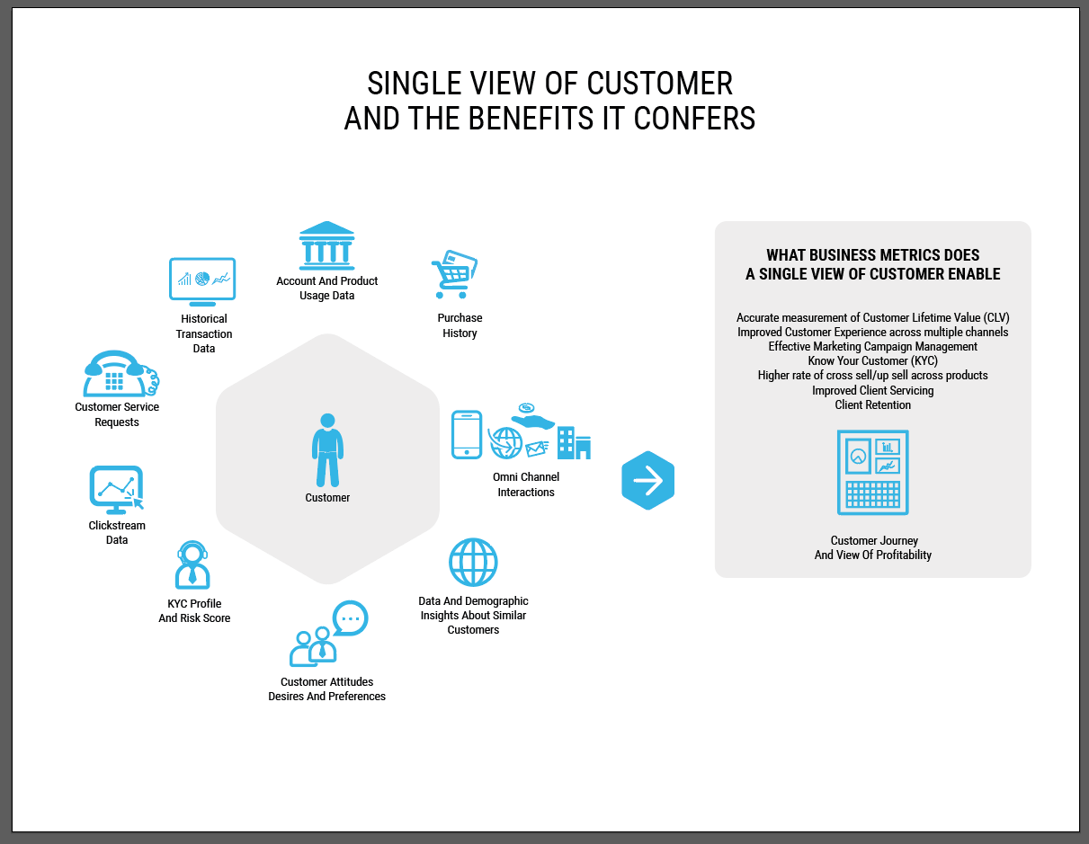
How to Detect Fraud ?

Slide 13
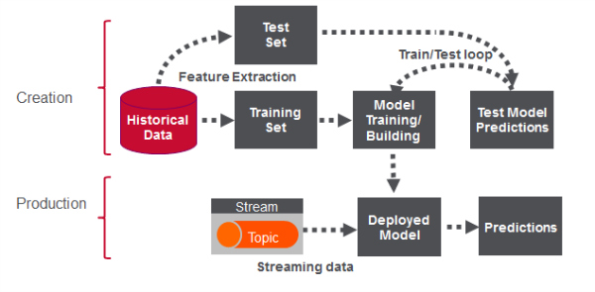
Fraud Detection in Real Life

Slide 14
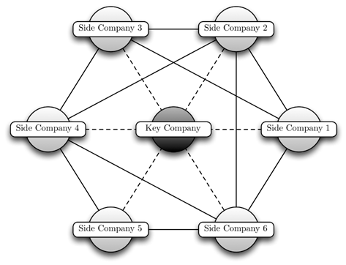
CASE STUDY 2 : SHELL COMPANIES
Notes:
The second case study is about Shell Companies. So what is a shell company? It is basically a small corporation that exists only on paper and has no office and no employees, but may have a bank account or may hold passive investments. These are used for tax evasion, money laundering or to achieve a specific goal such as anonymity.
This diagram shows a spider construction, which is a fraudulent setup for exchange of resources between the companies. The core of a spider construction is the key company, which is responsible for organizing the fraud, setting up many side companies and pruning away their proﬁts, so that they can go bankrupt. However, the key company has unobservable links, and therefore we can only detect the side companies. They do not transfer all of their resources to only one other company as this might attract too much attention, so they rather distribute their resources among many companies.
The side companies are the perpetrators of the fraud and have an observable link to each other through shared resources and thus analyzing the social aspects of these companies may lead to the identification of the fraud.

Slide 15
TECHNOLOGIES USED
Small networks or Initial/Partial analysis: –
Python / NetworkX
NodeXL, SVAT
Huge networks –
Graph databases, such as Neo4j – Distributed systems like Spark/Hadoop
Gephi
Notes:
So how to achieve this identification?
There are various technologies which can be used based on the complexity of the problem to visualize the scenario. For example, Python or SVAT may suffice for small networks, but Neo4j along with Gephi shows impressive results for bigger networks. The task of summarising and making interpretation, which was traditionally completed manually, can now be done with some programmes like Qlik or Tableau, which comprehensively display trends and variables, so that the whole story can be seen.
By using graphical approach and plotting all the suspected companies as nodes, along with their neighbors from social websites, the transactions can be analyzed to detect fraud activities. This will also lead to the prediction of fraud activity by the neighboring companies.

Slide 16
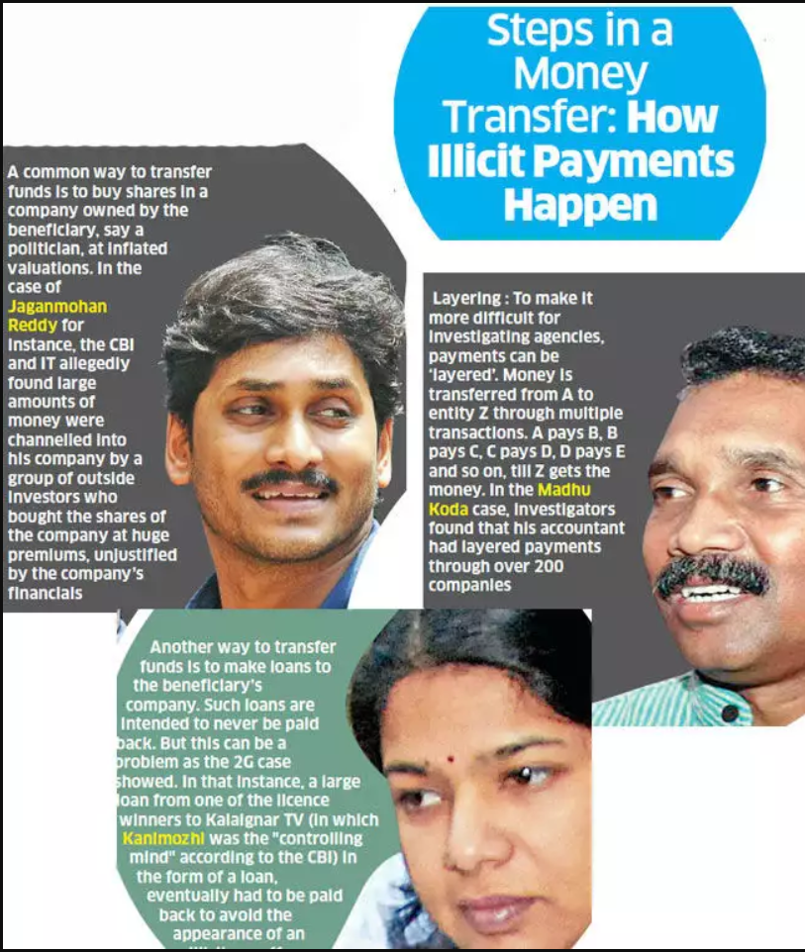
EXAMPLES

Slide 17
EXAMPLE: CENTURY COMMUNICATION GROUP
It used to run Mahua Channel [A Bhojpuri TV channel]
Committed fraud to the tune of Rs 3,000 crore
It used over 98 shell companies to allegedly divert bank loans for setting up digital studios in Noida, Mumbai, Kolkata and other locations.
Divert funds by showing fake equity infusion of about Rs 802 crore

Slide 18
METHOD OF DETECTING FRAUD
Focus on significant transactions
Trend Analysis
Unusual debits/credits in accounts
False credits, with corresponding debits, from/to dummy accounts, etc.
Ratio Analysis
Abnormal numbers / data
Historical Comparisons
Investigator’s Intuition & Common Sense
Notes:
Only when preventive measures and post-response actions complement each other can fraud risks be effectively deterred and controlled.

Slide 19


